Slide 1
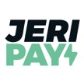
DCS SYNTHESIS
JERIPAY
ORDERING PAY DELIVER SYSTEM

Slide 2
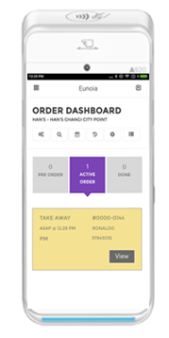
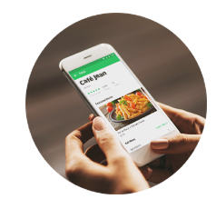
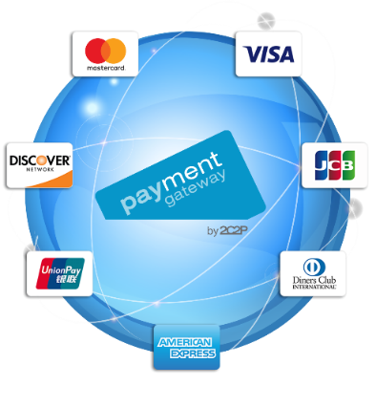
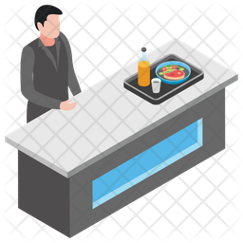
GUOCO TOWER CONCEPT
1. Customer Place the Order Online
2. Pay Using Credit card / Paynow / eWallets
3. Merchant Receive Notification and Prepare the Food
4. Driver will collect the Food from the Collection Counter and Deliver to Customer
3. Runner will Pick the Food
and send to Collection Counter at B2
5. Customer Received the Food

Slide 3
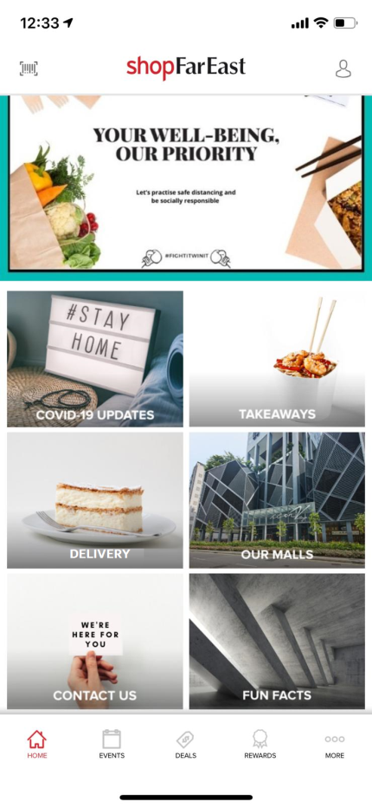
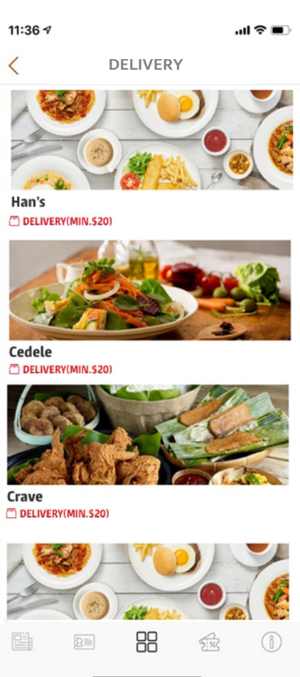
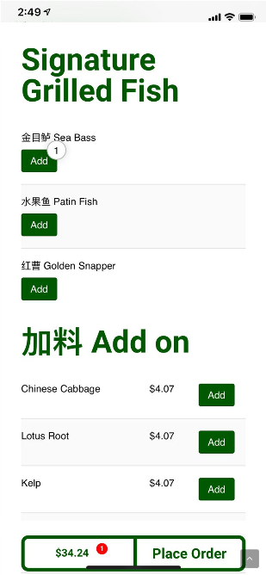
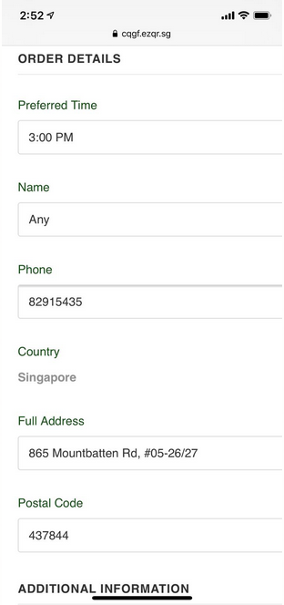
GUOCO TOWER CONCEPT
1. Click on Delivery
2. Choose Restaurant
3. Add Items to Cart
4. Key-in the Delivery Details

Slide 4
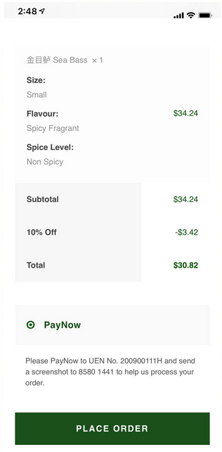
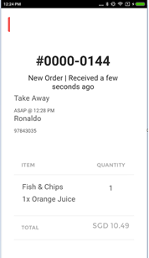
Can we set the lead time that orders are generated in the Jeripay terminal?
E.g. delivery date 2 June, 12pm placed on 1 June, 10pm.
Order should only be printed out from the terminal on 2 June, 10.30am
GUOCO TOWER CONCEPT
Order #: 0000-0144
Fish & Chips x 1
Orange Juice x 1
Is there a user guide provided for the usage of the Jeripay terminal?
DCS: Currently there is no option to configure lead time for receipt printing.
Receipt will be printed out on the Jeripay terminal once the order is made by the customer so as to be able to allow tenant to be able to reserve the existing stock (e.g. cakes) for the preorder.
5. Place the Order
6. Pay
7. Store Receives the Notification

Slide 5
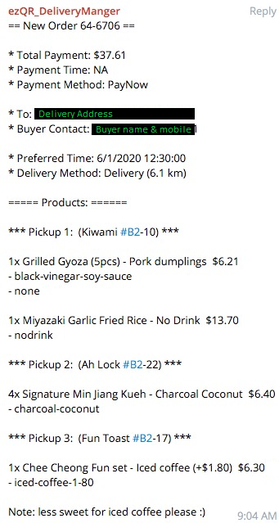
JERIPAY
Telegram (Delivery Manager)
For the backend admin portal, is there an outlet view where we can see all the pending items and orders based on outlet?
For the backend admin portal, is there a timeslot view where we can see all the pending items and orders based on each timeslot?
DCS: Refer to slide 6 for the Order Manager which can be exported to excel. The view can be sorted based on time.
Currently there is no outlet view, the team is exploring on the outlet view.
Telegram App
Integration with Telegram App
New order will be reflected in the group chat.
CAG team to assign runner to do food pick up
Will orders placed for delivery the next day be sent the moment they are ordered?
E.g. delivery date 2 June, 12pm placed on 1 June, 10pm.
Order will be sent in telelgram group on 1 June, 10pm?
Can we set the lead time that orders are sent to the telegram group?
DCS: There is no lead time for the orders that are sent to the telegram.
Sample Order Message

Slide 6
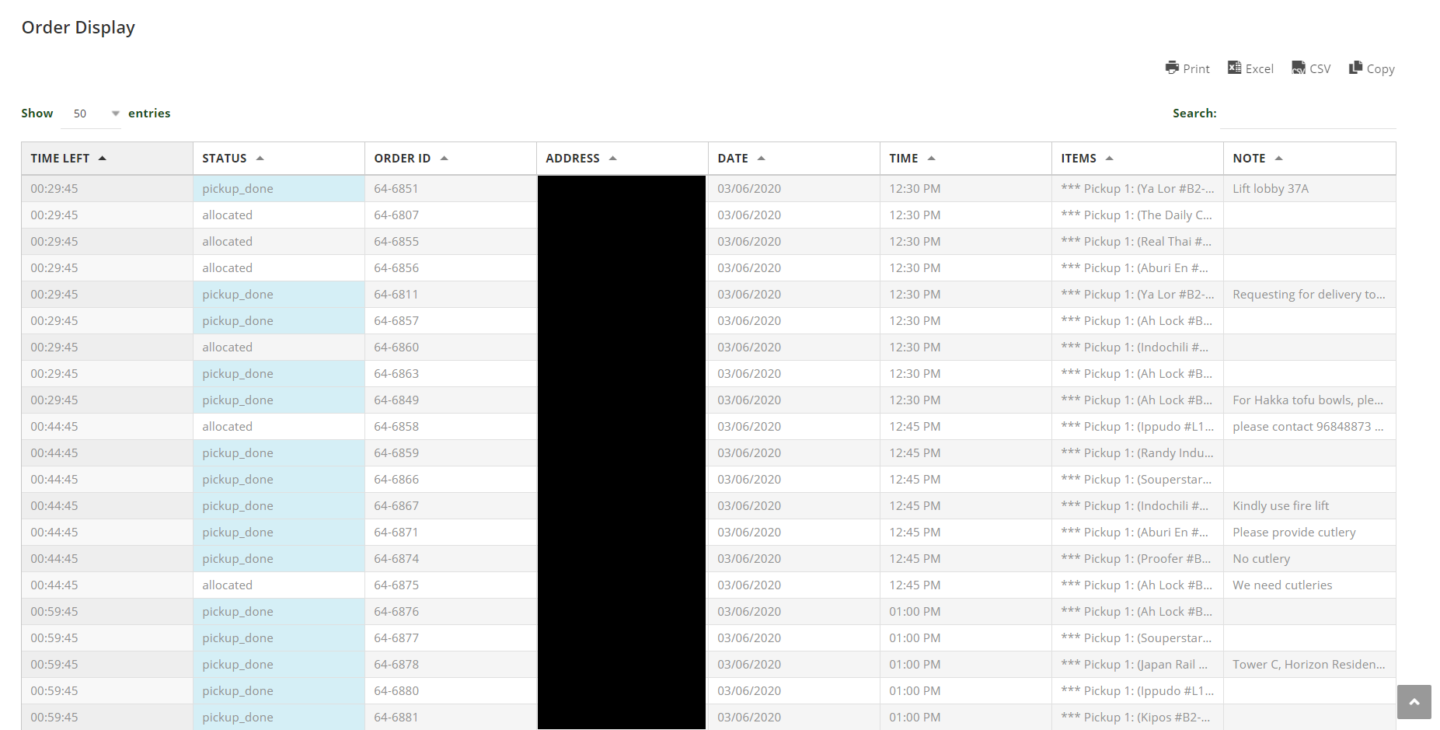
JERIPAY
Telegram (Delivery Manager)

Slide 7
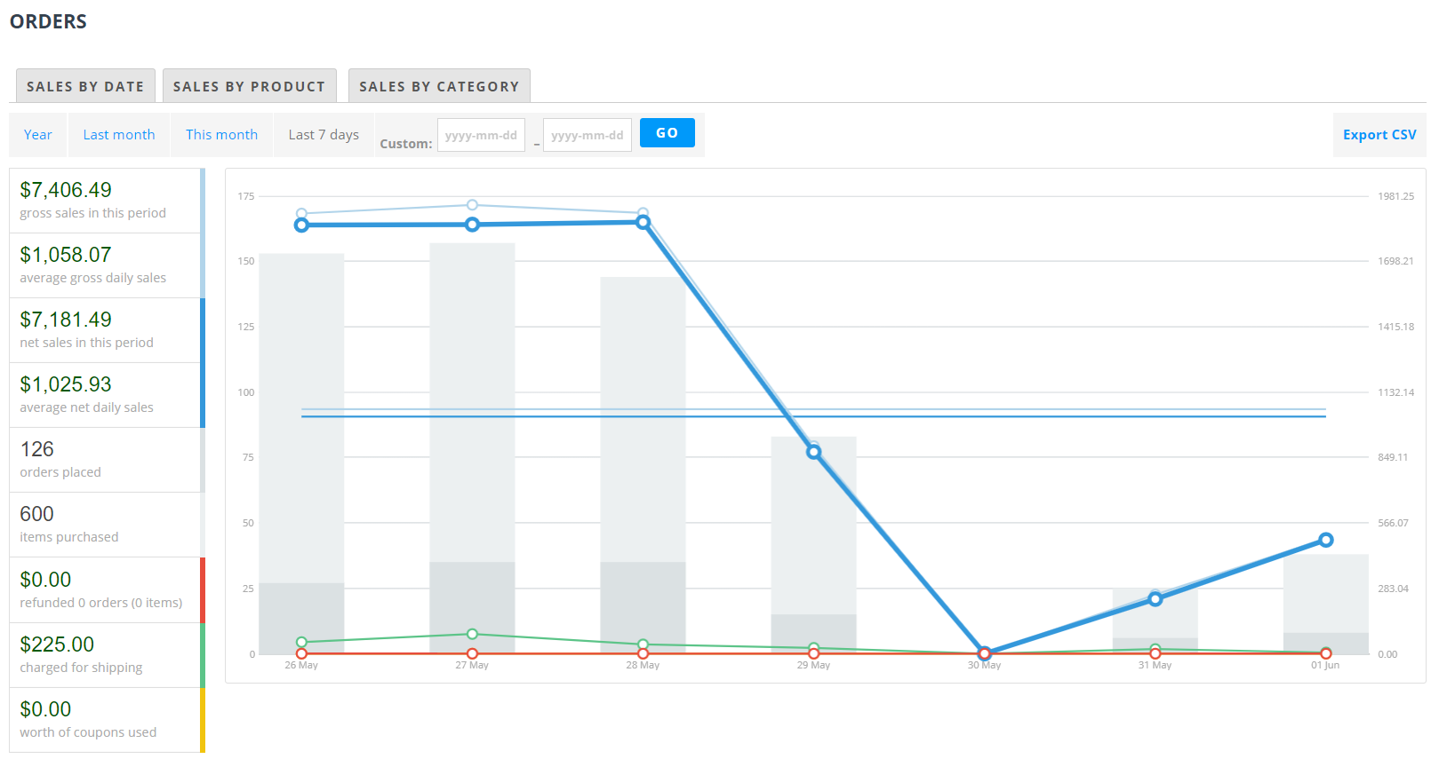
JERIPAY
Web Backend Sales Report
What does the CSV report look like?

Slide 8
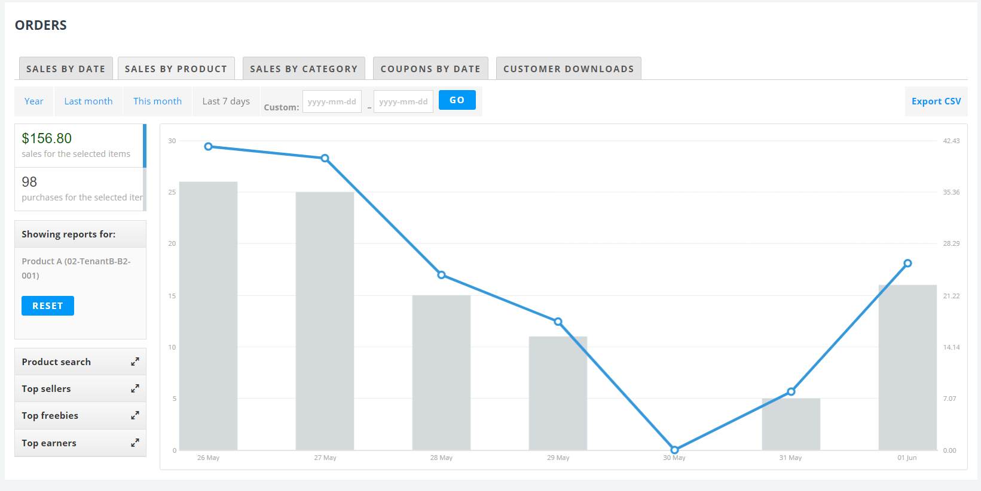
JERIPAY
Web Backend Sales By Product Report
What does the CSV report look like?

Slide 9
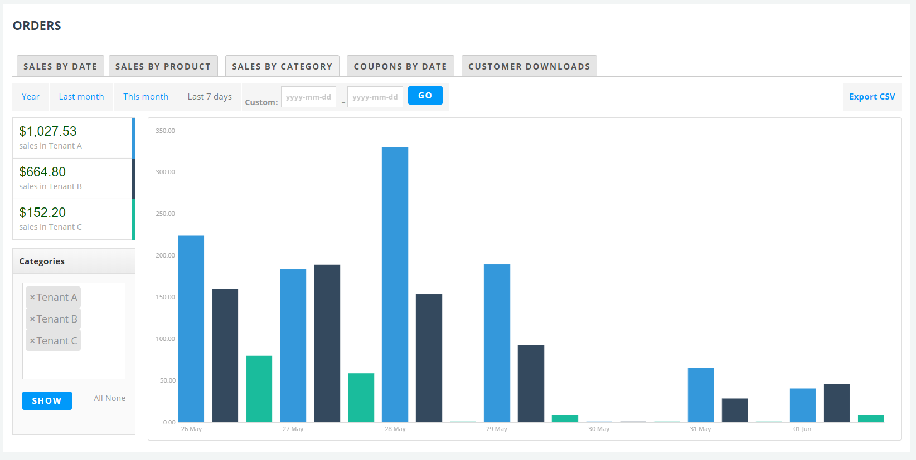
JERIPAY
Web Backend Sales by Category (Tenant) Report
What does the CSV report look like?

Slide 10
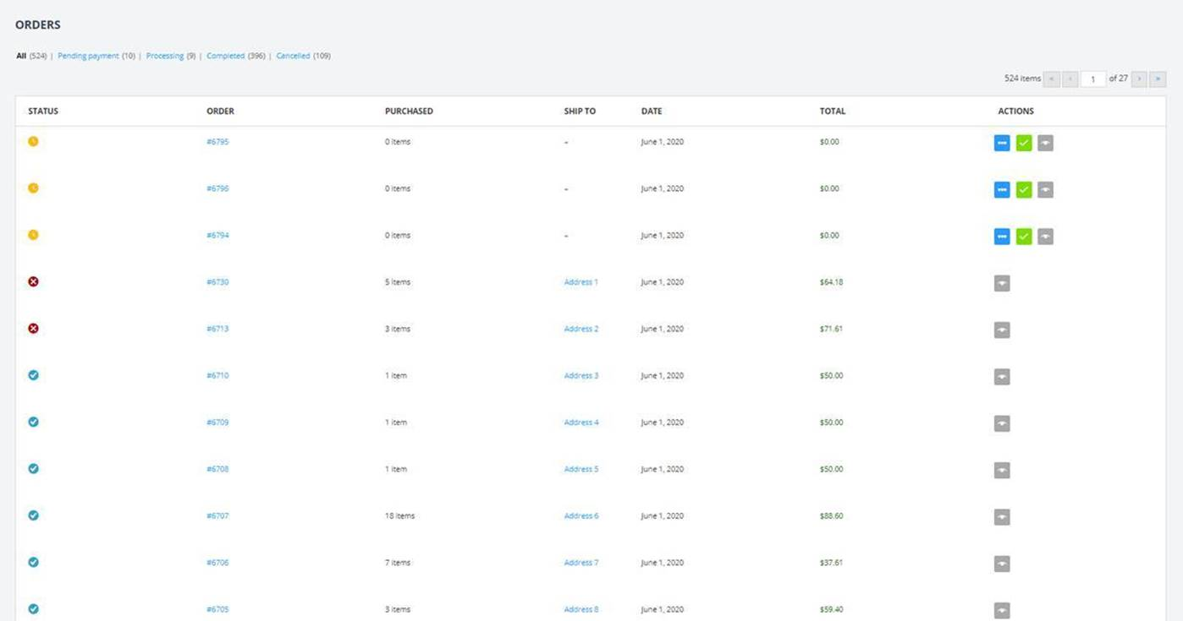
Backend Portal View by Orders

Slide 11
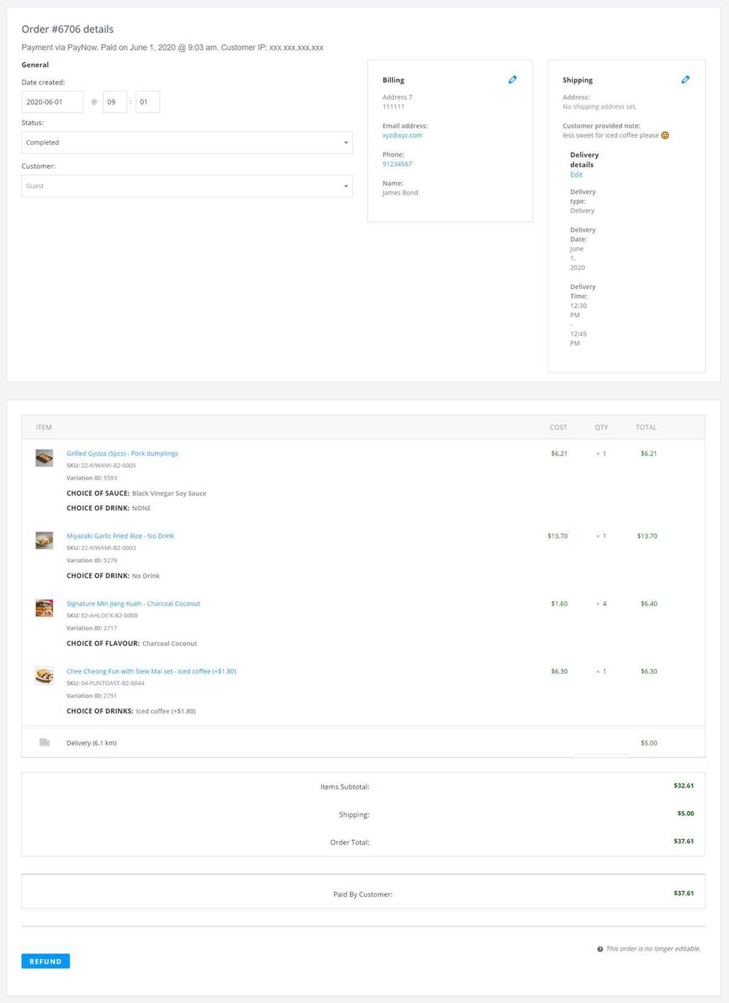
Backend Portal View for individual Orders

Slide 12
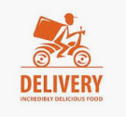
Food Delivery
DCS: There will be no additional pick up if drivers are picking from a single consolidated point
$2 per outlet pickup will not be charged since drivers are picking up from a single consolidated point
1500 Drivers on Standby
Within 6KM
Pick up food in 1 mall without consolidated point from
For deliveries below 6KM:
$6
For deliveries above 6KM:
$12
1 outlet $ 8.00
2 outlets $ 10.00
3 outlets $ 12.00
MONTHLY
Payment to drivers will be done by ezQR. ezQR will invoice CAG on a weekly basis for payment.
For each payment transfer to individual drivers = $0.50
Jeripay/ezQR to provide supporting evidence on number of transactions made
$105 SGD/M
deliver to one Address
When will orders be prompted to drivers to pick up?
Can we set the lead time that orders are sent to drivers to accept and come to Changi to pick up?
Anything above 6KM →
SUBSEQUENT 6KM
DCS: Delivery fees will be cap at $12 island wide.
$6.00
DCS: Lead time can be set.
E.g.: 2hr leadtime
12pm delivery, orders to be send to driver at 10am for drivers to accept
DCS: DCS/ezQR will bill CAG on weekly basis with supporting evidence on transaction made
30 to 45 Mins Delivery time

Slide 13
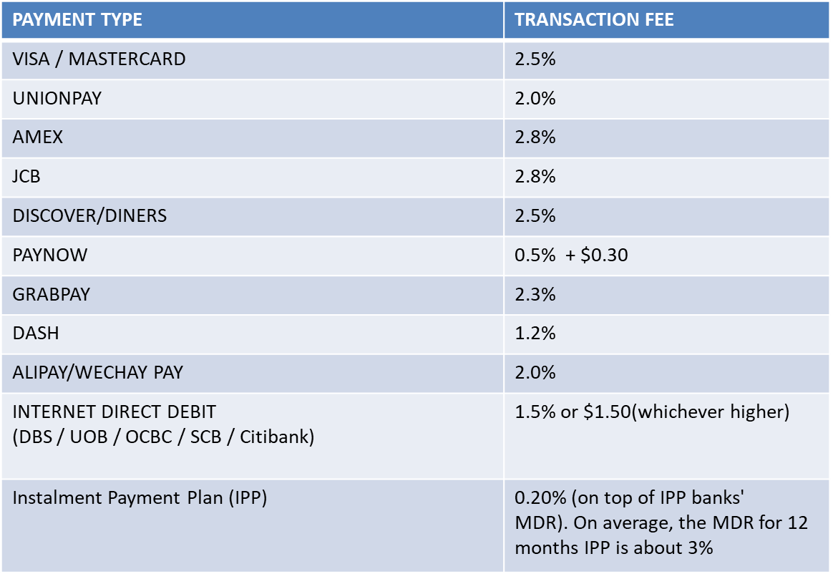
Online Transaction Rates
Transaction and Settlement currency: SGD
3.0%
MDR charges will be based on CAG’s agreement with 2C2P, not based on Jeripay’s agreement
3.0%
DCS: Yes, MDR charges will follow as per CAG’s agreement with 2C2P
1.5%
Card payment will be in 3DS. Require One-Time Password (OTP) to complete the transaction.
Settlement: T+2 or Weekly settlement on Week 2 Thursday, where Week 1 is from Saturday to Friday
Internet Direct Debit: Weekly settlement on Week 2 Thursday, where Week 1 is from Saturday to Friday

Slide 14
100 F&B STORES PRICING
 | Unit Price | Qty | Total
Standard System setup fees Inclusive: Standard Version Web Portal UI Customization (Color scheme, Logo) Add Changi Reward ID field at checkout page Orders Export report to include “Changi Reward ID” for each order item Platform maintenance is included and will continue as long as there are tenants onboard | S$ 7,000.00 | 1 time | S$ 7,000.00
Setup fee Per outlet includes: upload Menu item training onsite to retailer No max number of SKUs (max 10 SKU for initial setup due to processing time) Training guide to be provided deployment of Jeripay terminal onsite | S$ 450.00 one time No minimum number of merchants required | 100 merchants No minimum number of merchants required | S$ 45,000 .00 one time Amount billed will be based on number of merchants onboarded
Order Pay Delivery Merchant App Ride on Jeripay Terminal with SIM card and Monday to Sunday 10am to 10pm support No additional charges for additional uploading/changing of SKUs + images after initial setup | S$ 50.00 per month No minimum number of merchants required | 100 merchants No minimum number of merchants required | S$ 5,000.00 monthly 6 months Min Amount billed will be based on number of merchants onboarded Payment will be on a monthly basis
TOTAL |  |  | S$ 57,000 + GST
CAG to provide manpower (runner) to pick the food and bring it to the consolidation point.

Slide 15
Setting of delivery fee, minimum order value, free delivery value, and other shopping cart settings are configured by ezQR on the backend
No additional fees charged for such configurations, and configurations not limited to these items DCS: Setting of delivery fees, minimum order value and free delivery value can be configured by ezQR based on written request with lead time of 2 working days.
Maximum number of outlets that can be ordered from is 3. However, CAG can decide to reduce this number and ezQR will change the configuration accordingly at no charge
DCS: Maximum number of outlets can be rconfigured with written request with lead time of 2 working days.
Customized sales report will be generated on a daily basis and automatically sent to CAG
How is the sales report sent to CAG?
DCS: CAG to provide a designated email address. Report will be send on a daily basis.
Creation of coupon/promotion code can be managed by ezQR on a request basis at no additional cost. CAG can also self-manage at no additional cost
How can CAG self-manage? Through where?
DCS: Coupon creation can be done via the backend portal, however we recommend that coupon creation to be done by ezQR through written request.
Setting on order pickup location is configured by ezQR – there is no additional cost for changing the pickup location.
No additional charge will be imposed since drivers only need to pick up from a single location
DCS: No additional charge unless drivers were to do the picking from the stores.
Refunds to be handled by CAG team
How are refunds handled in the system?
DCS: CAG will be able to do the refund via the backend portal
Please provide the order invoice template
DCS: Will provide the invoice template

Slide 16
2C2P Payment Gateway PRICING
OPTION 1 (GUOCOTOWER CONCEPT) | Unit Price | Qty | Total
Main Merchant On-board (One time set up) | S$ 1,000.00 | 1 time | S$ 1,000.00
Main Merchant subsequent annual maintenance fee | S$ 600.00 | 1 time | S$ 600 .00
Sub Merchant On-board (One time set up) | S$ 50.00 | 100 merchants | S$ 5,000.00
Sub Merchant Monthly Maintenance | S$5.00 | 100 merchants | $S 500.00 6 Months Min Processing payment to retailer
TOTAL |  |  | S$ 11,000 + GST
CAG will not need to pay the Main Merchant setup and maintenance fees since we are using CAG’s master agreement with 2C2P – based on email clarification on 27 May
Is this the actual sub-merchant MID set up fees or should it be the amount quoted by 2C2P?
Is this amount on top of the sub-MID creation fees quoted by 2C2P?
DCS: Price quoted above is based on 2C2P pricing. Prices stated in the table is not applicable if CAG have separate arrangement with 2C2P. TBA by CAG & 2C2P.
It is possible to change the MID setup midway
Reconfiguration cost of $5,000.00

Slide 17
Question & Answer

