Slide 1
ezQR
order · pay · eat · now
Delivery Partners’ Guide

Slide 2
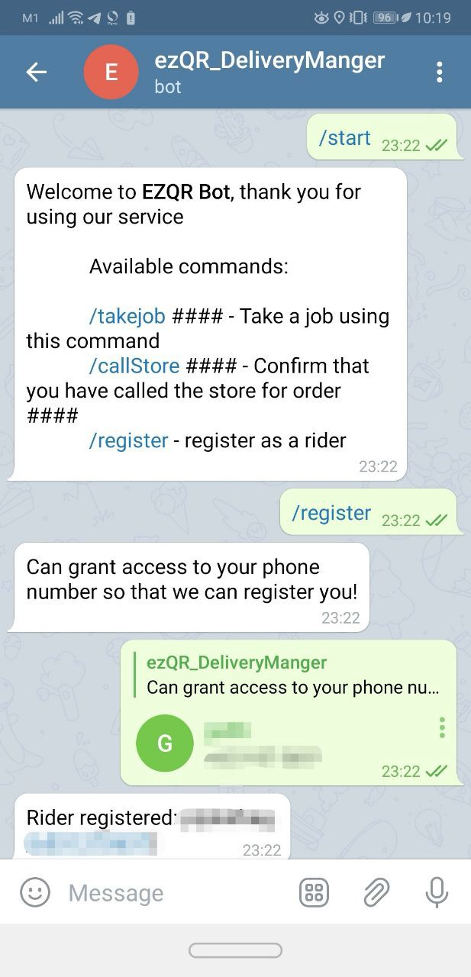
Registration
1
2
3
4
COMPLETE

Slide 3
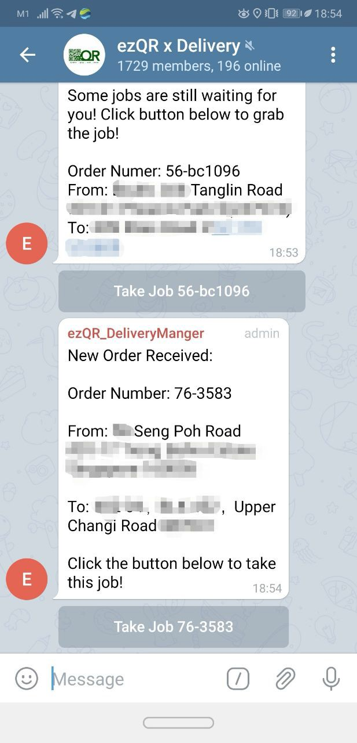
Accept Job
CRITICAL
Check all locations carefully before Taking Job. No release will be entertained for accidental acceptance.
1

Slide 4
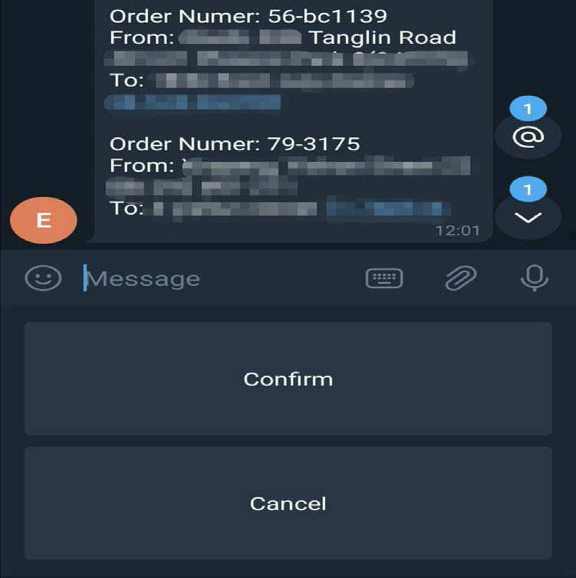
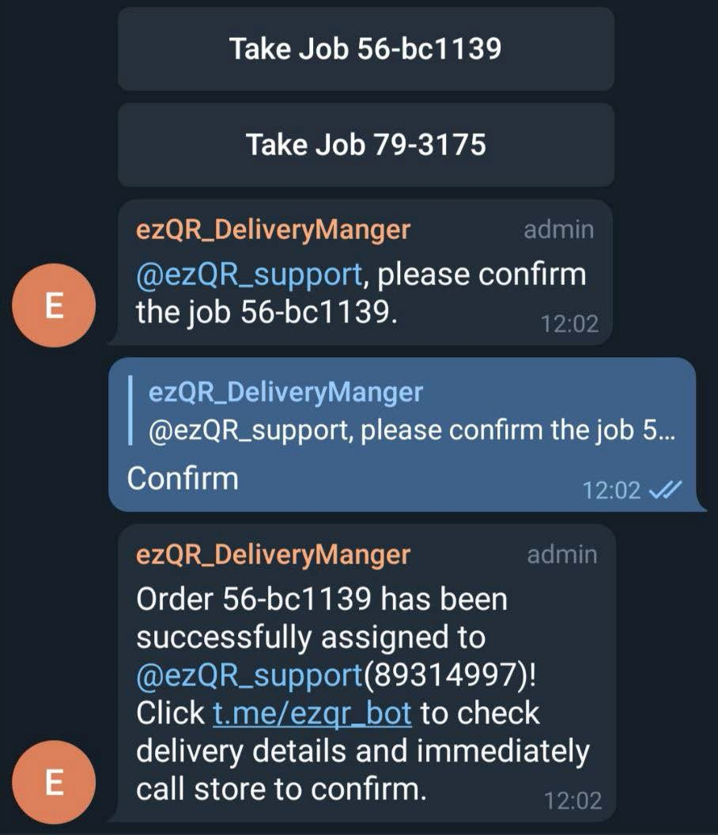
Accept Job
2
CONFIRMED

Slide 5
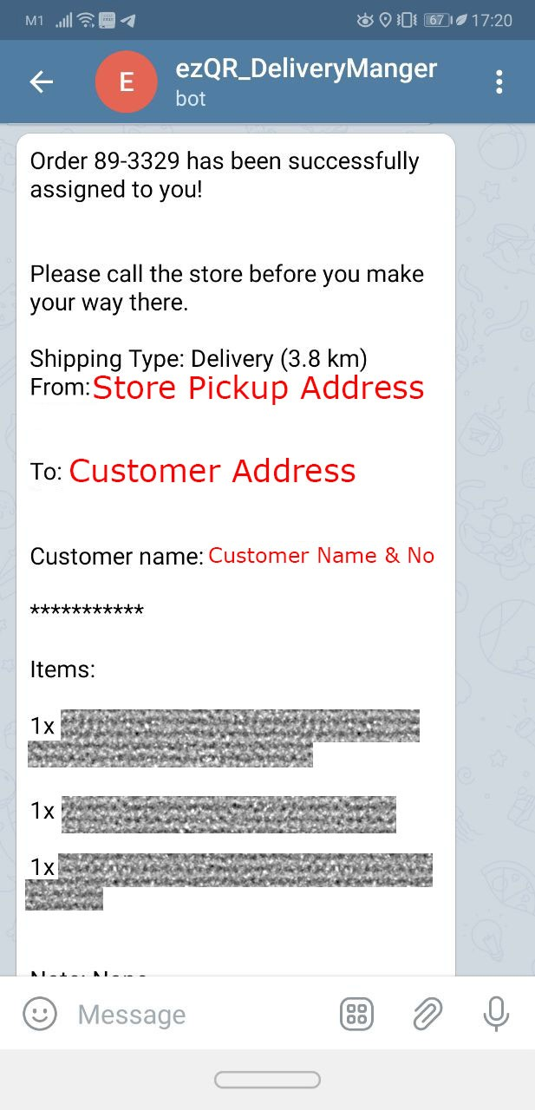
Manage Jobs
Store phone number
Upon accepting job, this will be sent to you from ezQR_DeliveryManager.

Slide 6
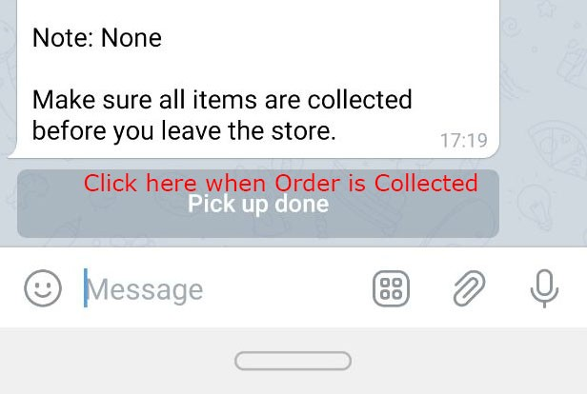
Manage Jobs
Follow the instructions on the message.
All contact details are provided: Store & Customer.
Call the Store before proceeding to collect.
Click “Pick up done” when order has been collected.
CRITICAL
Delivery partners must remain contactable via Voice and/or Messaging at all times.
When required to respond, do so with your vehicle safely stopped.

Slide 7
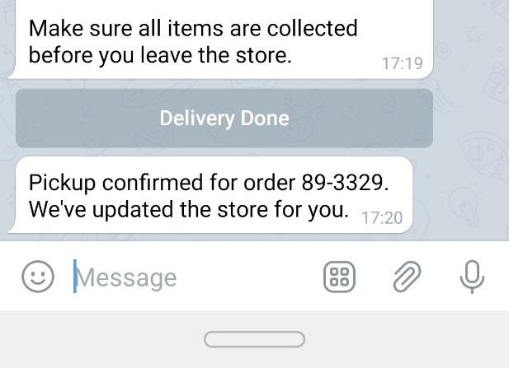
Manage Jobs
After clicking “Pick up done”:
Pickup confirmed message shows.
Button changes to “Delivery Done”
When you have delivered the order, click “Delivery Done”.

Slide 8
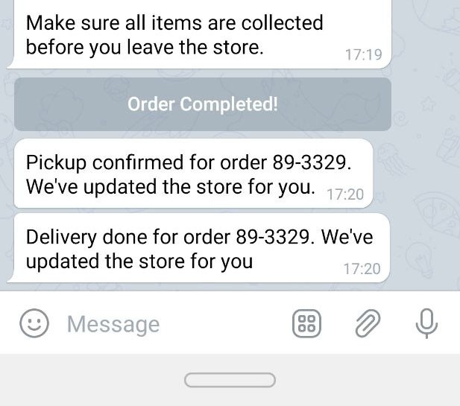
Manage Jobs
After clicking “Delivery Done”
Delivery done message shows.
Button changes to “Order Completed”
Order is completed and cleared from your system. This is a Job Clear.
Important:
You MUST always perform the Job Clear in a timely manner when picking up and delivering orders.
Failure to do so will cause problems.

Slide 9
Payment
All transactions are made directly between Store and Delivery Partner.
Payment is to be made upon collection of order at Store premises.
Current Rates are:
$6 delivery distance 6km and less
$12 delivery distance more than 6km
Rates are subject to revision without notice.

Slide 10
Cancelled Jobs
Delivery partners cannot cancel jobs,
nor can you request for a cancellation after you have accepted a job.
All accepted jobs MUST be fulfilled.
In the event where you are physically unable to complete the job, i.e. emergency situation or mechanical breakdown, contact ezQR Support.
If a job is cancelled by the Store or Customer, you will be informed by the Store directly.
If the job has been cancelled, perform a
Job Clear. (see Managing Jobs section)

